Slide 1
Operating System
Ch # 5

Slide 2
Process Synchronization
Cooperating Processes
can affect or be affected by other processes executing in the system
Can either
directly share a logical address space (Threads)
be allowed to share data only through files or messages

Slide 3
Critical Section
Critical Section:
Each process has a section of code in which process can
Update Variables
Update a table
Write a file etc
When one process is executing in its critical section , no other process is to be allowed to execute in its critical section
No two process are executing in their critical sections at the same time
Critical Section Problem: To design a protocol which processes can use to cooperate
Each process should request to enter its critical section (entry section)

Slide 4
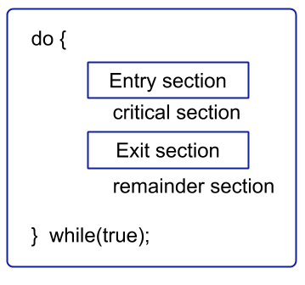

Slide 5
Solution to Critical-Section Problem
Mutual Exclusion - If process P_{i} is executing in its critical section, then no other processes can be executing in their critical sections.
Progress - If no process is executing in its critical section and some processes wish to enter their critical section, then the selection of the processes that will enter the critical section next cannot be postponed indefinitely. To decide which process (among many competing) can enter its critical section, only those processes can participate which are not in their remainder section.
Bounded Waiting - A bound must exist on the number of times that other processes are allowed to enter their critical sections after a process has made a request to enter its critical section and before that request is granted.

Slide 6
Hardware Synchronization
Process Synchronization refers to coordinating the execution of processes so that no two processes can have access to the same shared data and resources.
A problem occurs when two processes running simultaneously share the same data or variable
In Synchronization hardware, we explore several more solutions to the critical-section problem using techniques ranging from hardware to software based APIs available to application programmers.
Synchronization is the way by which processes that share the same memory space are managed in an operating system. It helps maintain the consistency of data by using variables or hardware so that only one process can make changes to the shared memory at a time

Slide 7
Synchronization Hardware
Normally, access to a memory location excludes other accesses to that same location.
Extension: designers have proposed machine instructions that perform two operations atomically (indivisibly) on the same memory location (e.g., reading and writing).
The execution of such an instruction is also mutually exclusive (even on Multiprocessors).
They can be used to provide mutual exclusion (restricted to shared processes) but other mechanisms are needed to satisfy the other two requirements of a good solution to the CS problem.

Slide 8
Many systems provide hardware support for critical section code
Uniprocessors – could disable interrupts
Currently running code would execute without preemption
Generally too inefficient on multiprocessor systems
Modern machines provide special atomic hardware instructions
Atomic = non-interruptable

Slide 9
Semaphore
Semaphore is simply a variable that is non-negative and shared between threads.
A semaphore is a signaling mechanism, and a thread that is waiting on a semaphore can be signaled by another thread.
It uses two atomic operations,
1) Wait
2) Signal for the process synchronization

Slide 10
Counting semaphore – integer value can range over an unrestricted domain
Binary semaphore – integer value can range only between 0 and 1; can be simpler to implement
Also known as mutex locks
Can implement a counting semaphore S as a binary semaphore
Provides mutual exclusion

Slide 11
Give a semaphore based solution for the following problem:
Execute statement B in Pj only after statement A has been executed in Pi
Use semaphore S initialized to 0
Pi Pj
 
A wait(S)
signal(S) B

Slide 12
Give a semaphore based solution for the following problem:
Statement S1 in P1 executes only after statement S2 in P2 has executed, and statement S2 in P2 should execute only after statement S3 in P3 has executed.
P1 P2 P3
  
S1 S2 S3
  
Semaphore A=0, B=0;
P1 P2 P3
  
wait(A) wait(B) S3
S1 S2 signal(B)
signal(A)
  

Slide 13
Semaphores provide a powerful tool for enforcing mutual exclusion and coordinating processes.
But wait(S) and signal(S) are scattered among several processes. Hence, difficult to understand their effects.
Usage must be correct in all the processes.
One bad (or malicious) process can fail the entire collection of processes.

Slide 14
Deadlock
Deadlock – two or more processes are waiting indefinitely for an event that can be caused by only one of the waiting processes (Traffic Deadlocks, One-way Bridge Crossing )
Deadlock is a situation that occurs in OS when any process enters a waiting state because another waiting process is holding the demanded resource.
Starvation – indefinite blocking. A process may never be removed from the semaphore queue in which it is suspended

Slide 15
Example of Deadlock
A real-world example would be traffic, which is going only in one direction.
Here, a bridge is considered a resource.
So, when Deadlock happens, it can be easily resolved if one car backs up (Preempt resources and rollback).
Several cars may have to be backed up if a deadlock situation occurs.

Slide 16
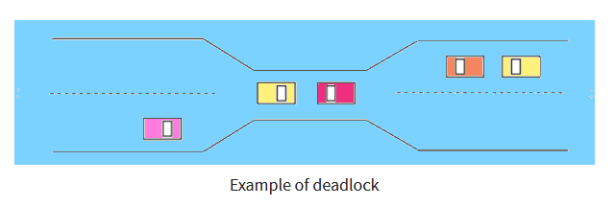

Slide 17
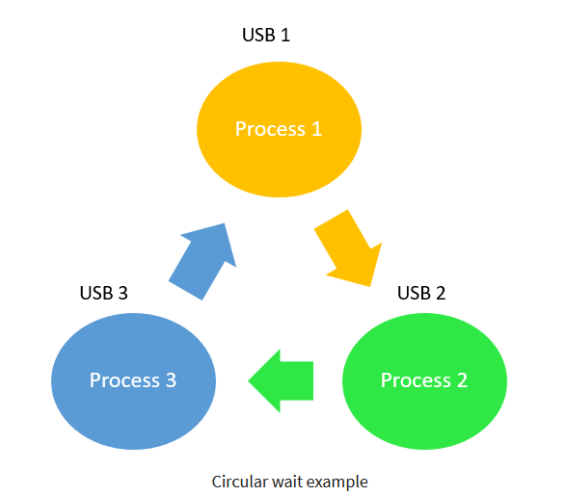
What is Circular wait?
One process is waiting for the resource, which is held by the second process, which is also waiting for the resource held by the third process etc.
This will continue until the last process is waiting for a resource held by the first process.
This creates a circular chain.

Slide 18
Circular Wait
For example, a computer has three USB drives and three processes.
Each of the three processes able to holds one of the USB drives.
So, when each process requests another drive, the three processes
will have the deadlock situation as each process will be waiting for the
USB drive to release, which is currently in use.
This will result in a circular chain.

Slide 19
Deadlock Detection in OS
A deadlock occurrence can be detected by the resource scheduler.
A resource scheduler helps OS to keep track of all the resources which are allocated to different processes.
So, when a deadlock is detected, it can be resolved using the below-given methods:
No-preemptive action
Mutual Exclusion
Hold and wait
Circular wait

Slide 20
Deadlock Prevention
It’s important to prevent a deadlock before it can occur.
The system checks every transaction before it is executed to make sure it doesn’t lead the deadlock situations.
Such that even a small change to occur dead that an operation which can lead to Deadlock in the future it also never allowed process to execute.
It is a set of methods for ensuring that at least one of the conditions cannot hold.

Slide 21
No preemptive action:
A resource can be released only voluntarily by the process holding it after that process has finished its task
If a process which is holding some resources request another resource that can’t be immediately allocated to it, in that situation, all resources will be released.
Preempted resources require the list of resources for a process that is waiting.
The process will be restarted only if it can regain its old resource and a new one that it is requesting.
If the process is requesting some other resource, when it is available, then it was given to the requesting process.
If it is held by another process that is waiting for another resource, we release it and give it to the requesting process.

Slide 22
Mutual Exclusion.
During concurrent execution of processes, processes need to enter the critical section (or the section of the program shared across processes) at times for execution.
It might so happen that because of the execution of multiple processes at once, the values stored in the critical section become inconsistent.
In other words, the values depend on the sequence of execution of instructions – also known as a race condition.
The primary task of process synchronization is to get rid of race conditions while executing the critical section.
This is primarily achieved through mutual exclusion.

Slide 23
Mutual Exclusion:
The mutual exclusion condition must hold.
That is, at least one resource must be non-sharable
A mutex lock cannot be simultaneously shared by several processes.
It is a special type of binary semaphore which used for controlling access to the shared resource.
Mutual exclusion allows current higher priority tasks to be kept in the blocked state for the shortest time possible.

Slide 24
Hold and Wait:
In this condition, processes must be stopped from holding single or multiple resources while simultaneously waiting for one or more others.
Circular Wait:
It imposes a total ordering of all resource types.
Circular wait also requires that every process request resources in increasing order of enumeration.

Slide 25
Recovery Form Deadlock
A. Process Termination: To eliminate the deadlock, we can simply kill one or more processes. For this, we use two methods:
Abort all the Deadlocked Processes:
Aborting all the processes will certainly break the deadlock, but with a great expense.
The deadlocked processes may have computed for a long time and the result of those partial computations must be discarded and there is a probability to recalculate them later.
Abort one process at a time until deadlock is eliminated:
Abort one deadlocked process at a time, until deadlock cycle is eliminated from the system.
Due to this method, there may be considerable overhead, because after aborting each process, we have to run deadlock detection algorithm to check whether any processes are still deadlocked.

Slide 26
B. Resource Preemption: To eliminate deadlocks using resource preemption, we preempt some resources from processes and give those resources to other processes. This method will raise three issues –
Selecting a victim:
We must determine which resources and which processes are to be preempted and also the order to minimize the cost.
Rollback:
We must determine what should be done with the process from which resources are preempted. One simple idea is total rollback. That means abort the process and restart it.
Starvation:
In a system, it may happen that same process is always picked as a victim. As a result, that process will never complete its designated task.
This situation is called Starvation and must be avoided. One solution is that a process must be picked as a victim only a finite number of times.

Slide 27
Banker’s Algorithm
The banker’s algorithm is a resource allocation
and deadlock avoidance algorithm that tests for safety by simulating the allocation for predetermined maximum possible amounts of all resources,
then makes an “s-state” check to test for possible activities, before deciding whether allocation should be allowed to continue

Slide 28
Write a detail report on
Producer Consumer Problem In Operating System

